Slide 1
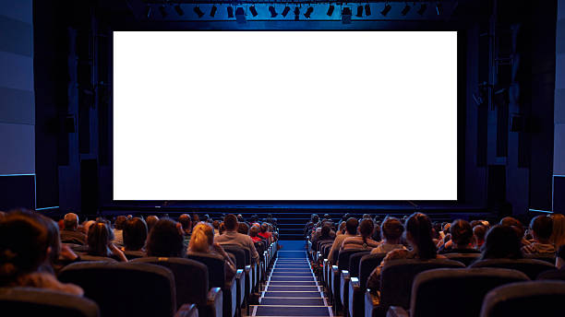

It’s Back!! 2024-25 Contest

Slide 2
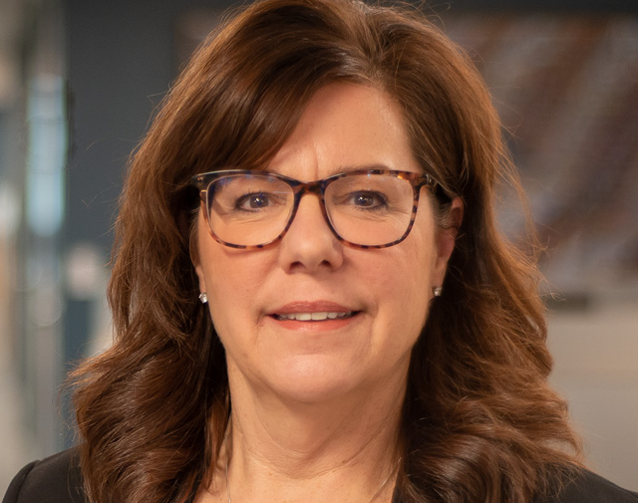
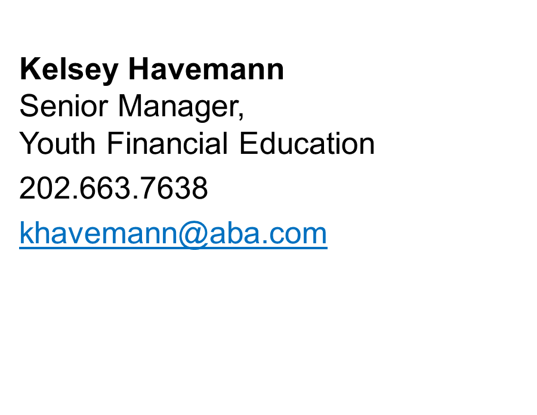
ABA Point of Contact
aba.com/LightsCameraSave

Slide 3
Housekeeping
Webinar is being recorded.
Slides and recording will be emailed.
Ask questions in the Q&A pod.
We’ll get to questions at the end!
aba.com/LightsCameraSave

Slide 4

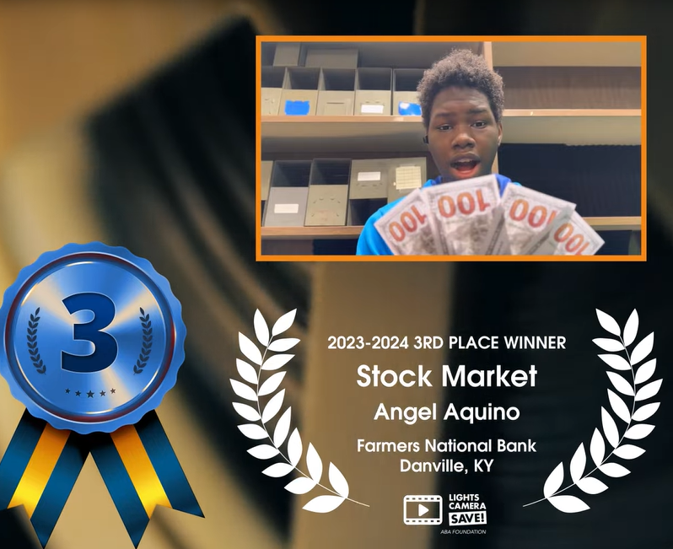
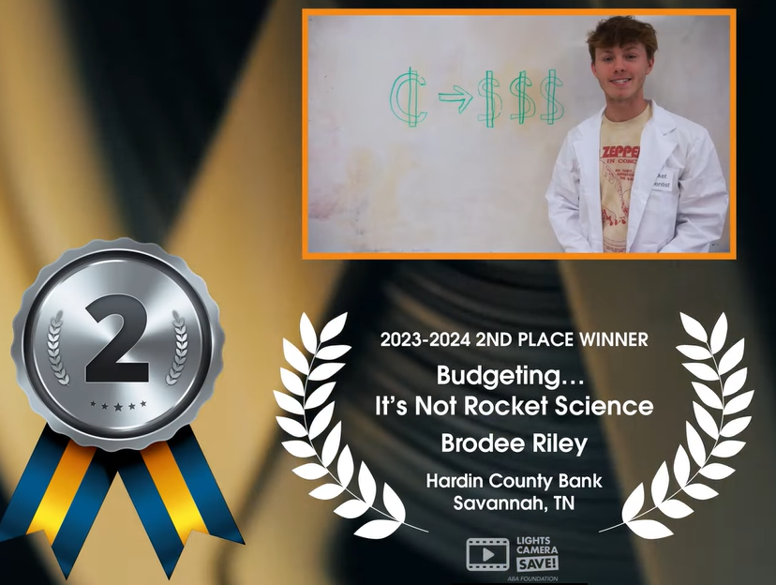
WHAT is Lights, Camera, Save?
Video contest for teens
Chance to give away someone else’s $$$$$
EASY engagement in your community
2023-24 Winners
aba.com/LightsCameraSave

Slide 5

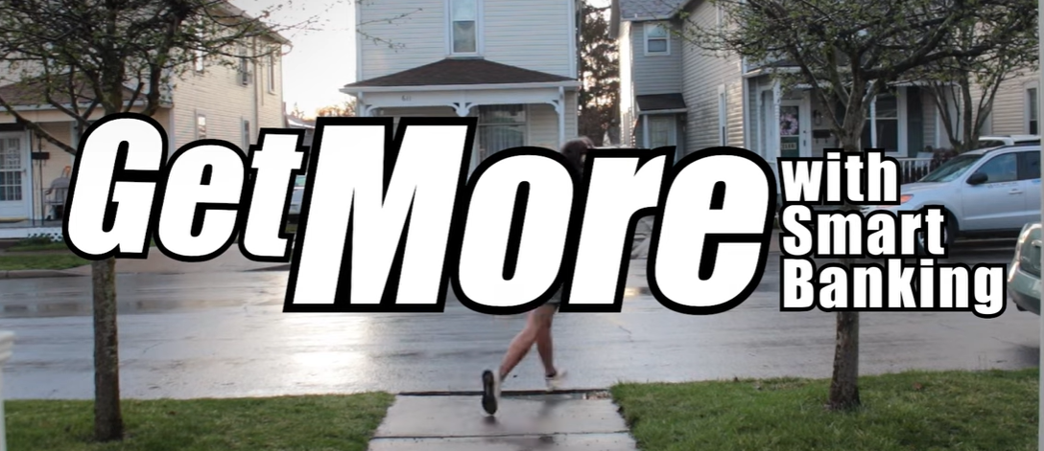
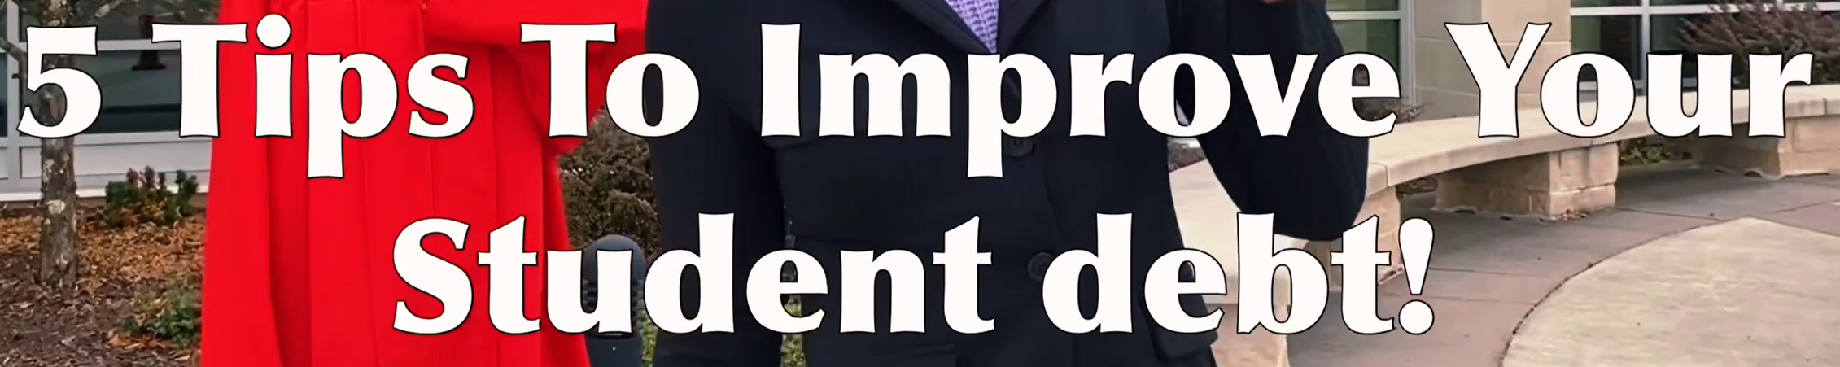

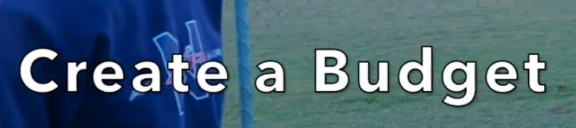
WHY Lights, Camera, Save?
Engage teens in their existing world
Literally TURNKEY for you
Builds community TRUST
Great PR for your bank
Kids Teaching kids
aba.com/LightsCameraSave

Slide 6
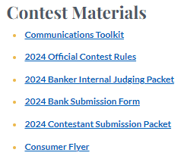
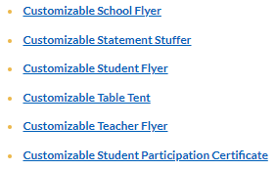
HOW Lights, Camera, Save?
Go to: aba.com/lightscamerasave to register then you’ll get the link to the resource page!!
aba.com/LightsCameraSave

Slide 7

WHO Lights, Camera, Save!
Calling all Marketers
#1 Hit your SCHOOLS!!!!!
  production classes
  clubs like DECA/FBLA)
USE the Socials
Community Theaters/Centers
Find Local chapters
  Girl Scouts
  Jump$tart
  Junior Achievement
  SkillsUSA
  State Film Commission Offices
aba.com/LightsCameraSave

Slide 8

WHERE Lights, Camera, Save!
Bankers:
aba.com/LightsCameraSave
Non-Bankers:
lightscamerasave.com
Direct all marketing to lightscamerasave.com
aba.com/LightsCameraSave

Slide 9

WHEN Lights, Camera, Save!
Contest Opens Oct 1 - Dec 1
  Students must be 13-18 years of age
  as of October 1, 2024
Length: 30 seconds or less
Topic: ANY personal finance theme
Submission: Electronic only
aba.com/LightsCameraSave

Slide 10

Video Selection
Scoring Criteria:
  40% Messaging
  30% Production Value
  30% Creativity
Bank Judging: Dec 2 – 9
  Student File Upload to ABA:
  By Jan 5, 2025
Instagram Judging: Jan 14–17
Final Round: Jan 21 – 24
Winner Announcement: February 24, 2025
aba.com/LightsCameraSave

Slide 11

Show Me the Money!!
Local Prizes: Optional
Up to each bank
National Prizes:
  1st Place - $5,000
  2nd Place - $2,500
  3rd Place - $1,000
Bankers Choice: $500+ Bundle
  Voted on and awarded at ABA’s Annual Community Bankers Conference in February 2025
aba.com/LightsCameraSave

Slide 12
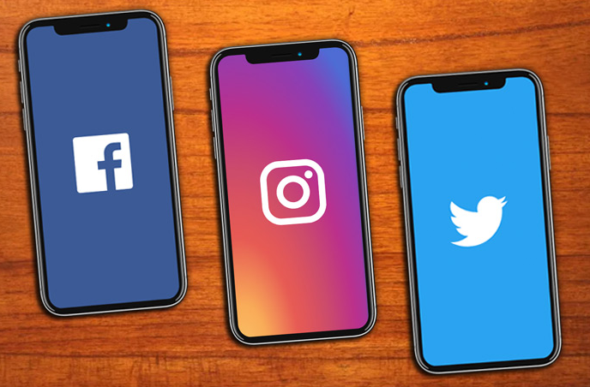
Social for Lights, Camera, Save!
#LightsCameraSave
  Use the hashtag on Facebook, Twitter and Instagram so that your posts are discoverable by ABA and others
Follow Us!
Facebook:@AmericanBankersAssociation
Instagram: @americanbankersassociation
Twitter: @ABABankers
aba.com/LightsCameraSave

Slide 13

WHERE Lights, Camera, Save!
Register to Participate
FREE to Any Bank in USA
aba.com/LightsCameraSave

Slide 14




ABA Foundation has set a three-year, industry-wide goal:
enable 5 million Americans to access pathways to prosperity.
Join us by participating in these free programs.
aba.com/FinEd

Slide 15

aba.com/Foundation

